Slide 1
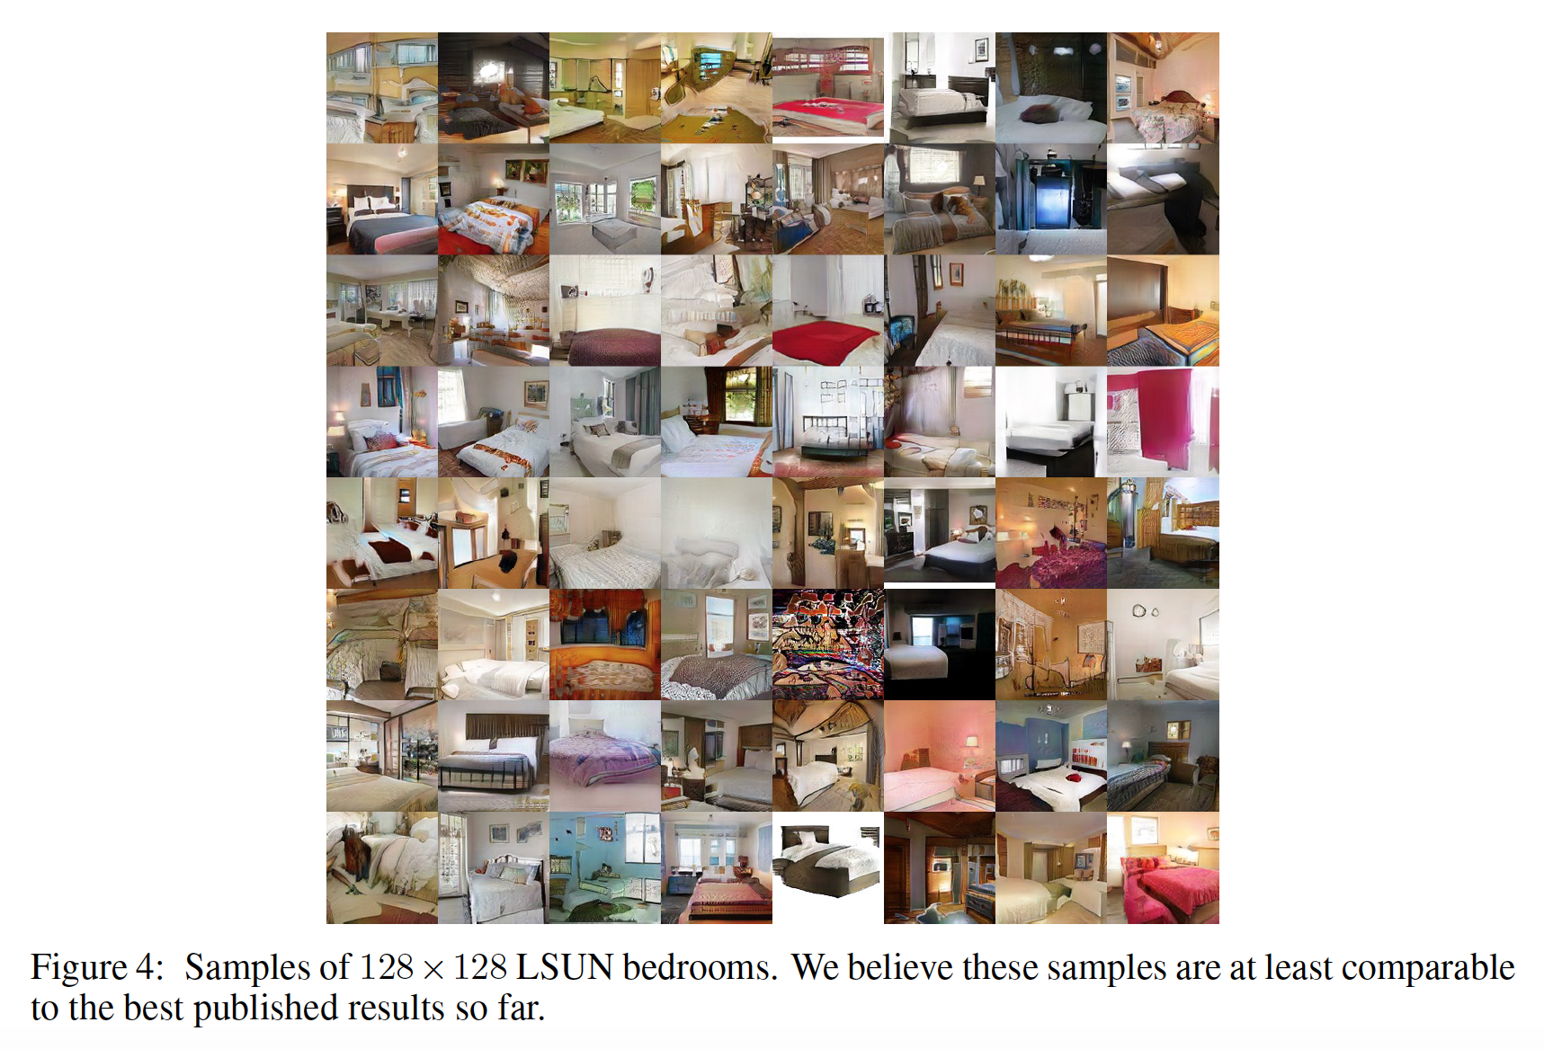
Improved Training of Wasserstein GANs
Ishaan Gulrajani, Faruk Ahmed, Martin Arjovsky, Vincent Dumoulin, Aaron Courville
Group members：
Cheng lu
Wu minxuan
Jiang fan
Jiang qiyao

Slide 2
Content
01
02
ABSTRACT
BACKGROUND
03
DIFFICULTIES AND IMPROVEMENT
EXPERIMENTS
04
CONCLUSION
05

Slide 3
ABSTRACT

Slide 4



ABSTRACT
powerful generative models
suffer from training instability.
making progress toward stable training
generating poor sample or fail to converge sometimes
proposing an alternative to clipping weights: penalize the norm of gradient of the critic with respect to its input.
WGAN
WGAN-GP
GANs

Slide 5
BACKGROUND

Slide 6
BACKGROUND
GANs
What is it?
How does it work?
WGAN
Cons of GANs
How to solve these?

Slide 7
BACKGROUND
Generative
Adversarial
Networks
FAKE
MAKER
It is used to
create worlds similar to our own in many domain: images, music, speech, etc.

Slide 8
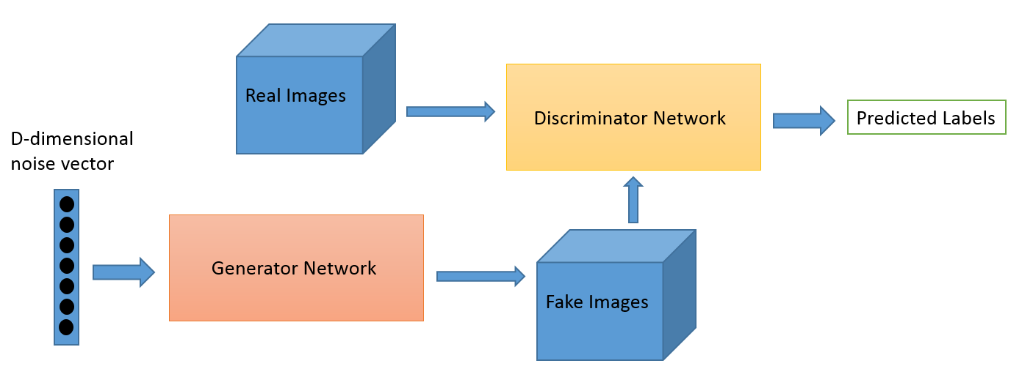

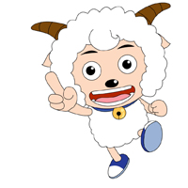
BACKGROUND
How does GANs work?
G
(Generator)
Cheating
D
(Discriminator)
Making it stronger
maps a source of noise to the input space
discriminates between output and true data
(cr: O’Reilly)

Slide 9
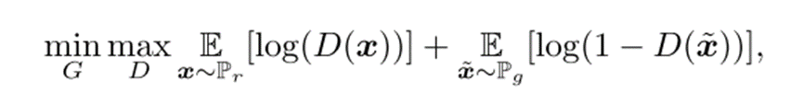
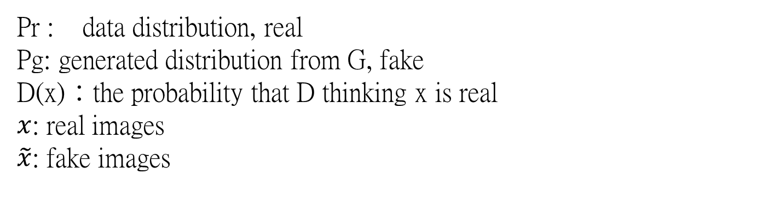
BACKGROUND
How does GANs work?
G
(Generator)
D
(Discriminator)
Pr : data distribution, real
Pg: generated distribution from G, fake
D(x)：the probability that D thinking x is real
$x$: real images
$\tilde{x}$: fake images
Notes:
In math

Slide 10

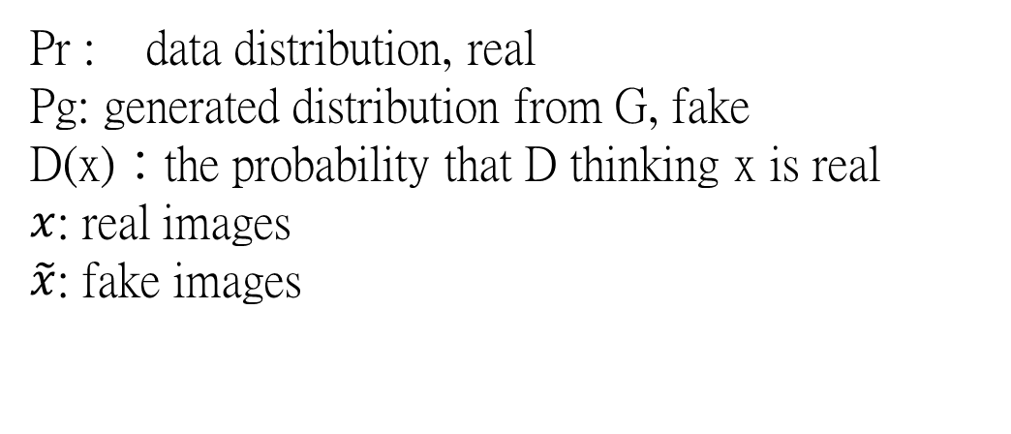
BACKGROUND
How does GANs work?
G
(Generator)
D
(Discriminator)
Expecting D(x) close to 1
Expecting D($\tilde{x}$) close to 0
Pr : data distribution, real
Pg: generated distribution from G, fake
D(x)：the probability that D thinking x is real
$x$: real images
$\tilde{x}$: fake images

Slide 11

BACKGROUND
How does GANs work?
G
(Generator)
D
(Discriminator)
Cannot influence this part.
Expecting D($\tilde{x}$) close to 1
Pr : data distribution, real
Pg: generated distribution from G, fake
D(x)：the probability that D thinking x is real
$x$: real images
$\tilde{x}$: fake images

Slide 12

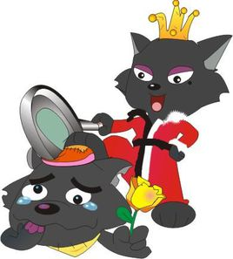
BACKGROUND
Cons of GANs
Unstable（ JS divergence ）
He runs so fast that I cannot catch up with him !
I have caught a sheep. If I continue to hunt and leave him here, he may run away and my wife will punish me. So I would just stay here with one sheep.
Catch me if you can!
JS divergence (estimating the distance between the real distribution and the generated distribution)
When the discriminator is perfect, JS divergence will results in vanishing gradients of generator.
G(generator) gets stuck in local optimal
Mode collapse （ KL divergence ）
D
(Discriminator)
Generating the same picture
KL divergence’s asymmetry results in G(generator) preferring safety rather than variety.
G
(Generator)
G
(Generator)

Slide 13
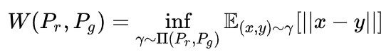
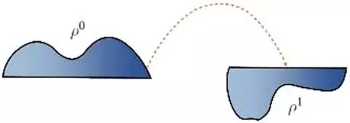
BACKGROUND
How to solve those?
Distance
Wasserstein
Wasserstein
Generative
Adversarial
Networks
Earth-Mover: the minimal cost of moving the points in one distribution to another.
Instead of JS, it can estimate the distance even though two distributions are located in lower dimensional manifolds without overlaps
Providing a smooth measure
Generated distributionl
Use this as GAN loss function
real distributionl

Slide 14
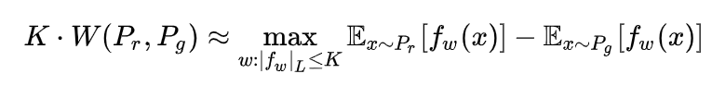
BACKGROUND
How to solve those? WGAN
Difficult to compute
+ Lipschitz constant K
How to define the constraint K?
Weight Clipping: Limit the range of w
I will control my running speed
so that G could know where I am.
D
(Discriminator)

Slide 15
BACKGROUND
GANs
WGAN

Slide 16
BACKGROUND
GANs
NO Sigmoid(for D)
NO Log(for loss function of G&D)
Weight Clipping
WGAN

Slide 17
DIFFICULTIES AND IMPROVEMENT

Slide 18
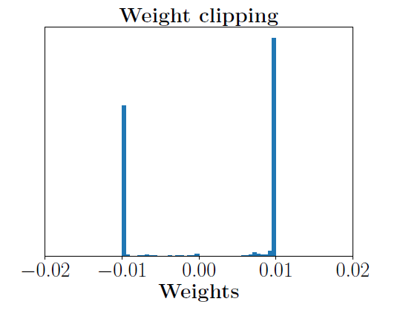
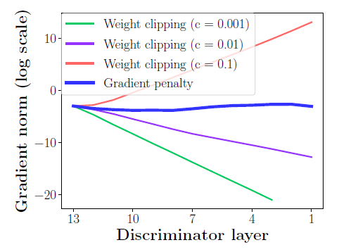
DIFFICULTIES AND IMPROVEMENT
DIFFICULTIES
Capacity underuse
Exploding and vanishing gradients
Limiting the |wi| to a constant C
interactions between the
weight constraint and the cost function
vanishing or exploding gradients
Most weights are
0.01(max value)
or -0.01(min value)
The model is quite simple
Notes:
Because the

Slide 19
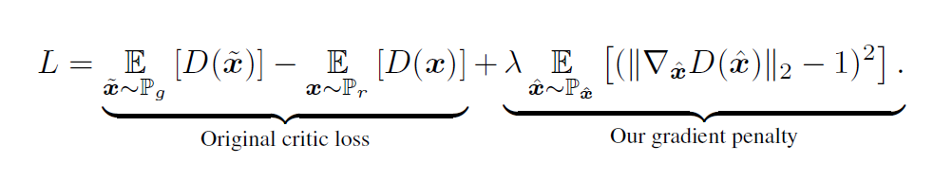
DIFFICULTIES AND IMPROVEMENT
Gradient penalty
How does it come out

Slide 20
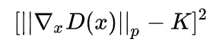
DIFFICULTIES AND IMPROVEMENT
Gradient penalty
D(Discriminator) goals:
Discriminate the real and the fake
Satisfying the limitation K
WGAN:
Lipschitz constant K
slow down the speed of gradient descend
Conclusion：
Closer to the defined constant,
the better.
Minimize

Slide 21
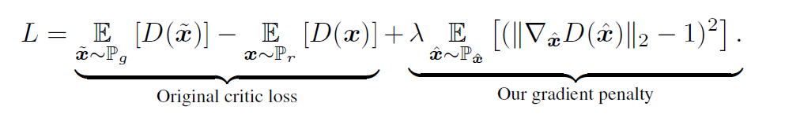
DIFFICULTIES AND IMPROVEMENT
WGAN
WGAN-GP

Slide 22
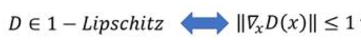
DIFFICULTIES AND IMPROVEMENT
WGAN
WGAN-GP

Slide 23
EXPERIMENTS

Slide 24
GENERATED IMAGES

Slide 25
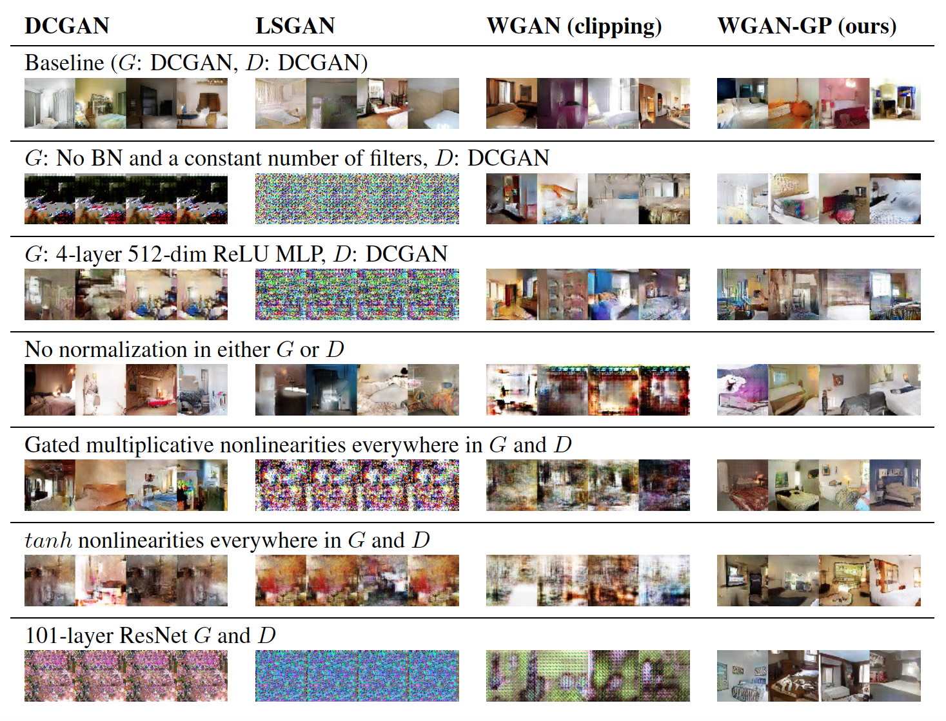
GENERATED IMAGES

Slide 26
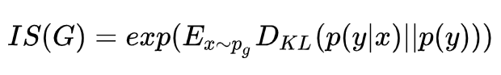
ADVANTAGE
The advantage of WGAN-GP is improved training speed and sample quality
Use Inception Score to measure model performance:
The quality of the generated images
The diversity of the generated images
Higher value of Inception Score indicates relatively better performance

Slide 27
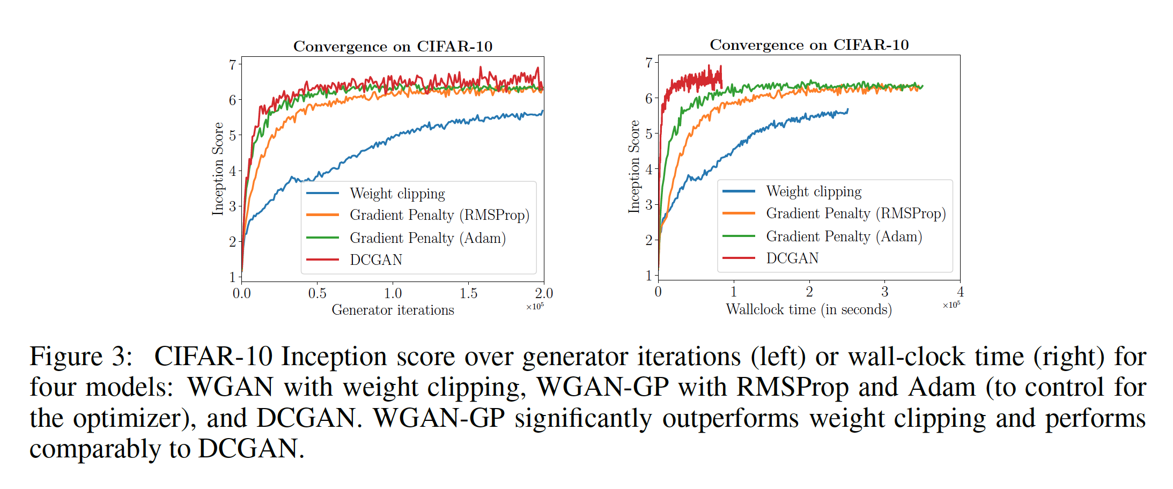
COMPARISON

Slide 28
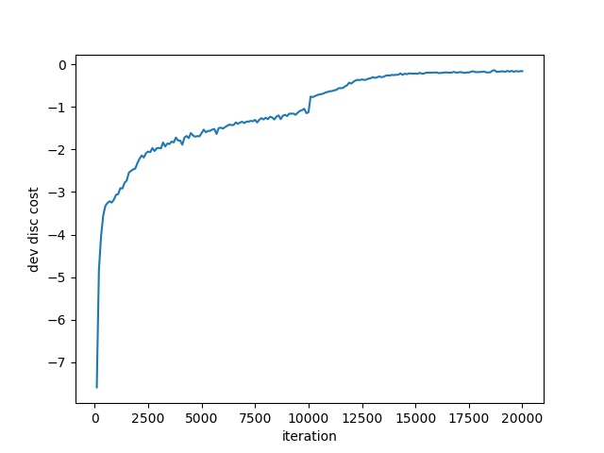
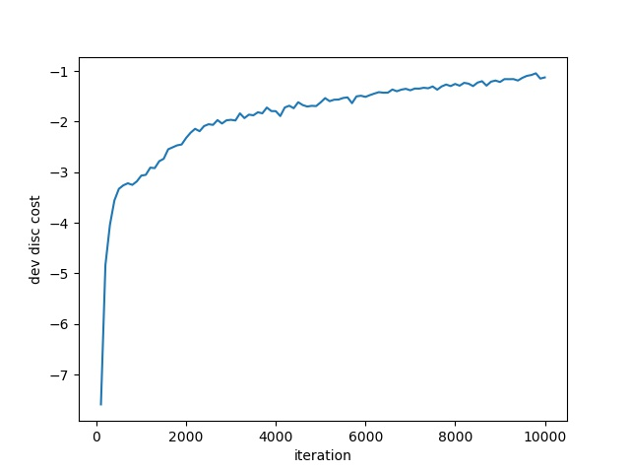
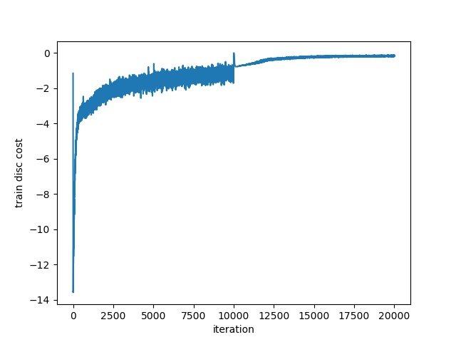
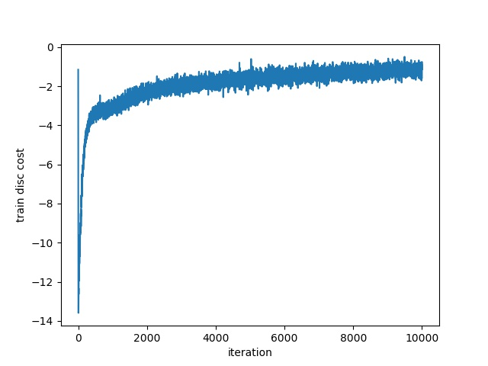
Cost function
Wgan-gp
Wgan
No overfitting, train-cost and valid-cost converge

Slide 29
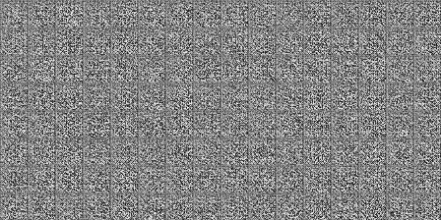
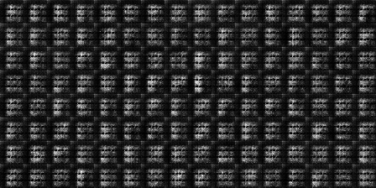
demo
Wgan
Wgan-gp

Slide 30
CONCLUSION

Slide 31
CONCLUSION
demonstrated problems with weight clipping in WGAN
introduced an alternative in the form of a penalty term in the critic loss
demonstrated strong modeling performance and stability across architectures.
contribution
modeling performance on large-scale dataset
adapt penalty term to the standard GAN objective function to stabilize training
GP takes effect only upon the sampled point, additionally lay the Lipschitz continuity condition over the manifold of the real data
What can be improved

Slide 32
Thank you

